Slide 1
Network Security in WSN

Slide 2
Challenges
Anyone can monitor or participate in the communication in a wireless channel. This provides a convenient way for attackers to break into a network.
Most protocols for WSNs do not consider necessary security mechanisms at their design stage. Also most protocols are publicly known due to the needs for standardization. Hence attackers can easily launch attacks by exploiting security holes in those protocols.
The constrained resources in sensor nodes make it very difficult to implement strong security algorithms on a sensor platform due to their complexity. In most cases, symmetric key cryptography is the first choice for designing a security protocol for WSNs, though public key cryptography is possible under careful optimization in design and implementation.
Due to huge number of sensor nodes the security protocol should be simple, flexible, and scalable.
A stronger security protocol costs more resources in sensor nodes, which can lead to the performance degradation of applications. In most cases, a trade - off has to be made between security and performance. Weak security protocols may be easily broken by attackers.
WSN is usually deployed in hostile areas without any fixed infrastructure. It is difficult to perform continuous surveillance after network deployment. Therefore, it may face various potential attacks.

Slide 3
Security Concepts
Confidentiality
Integrity
Authenticity
Non-repudiation
Freshness
Availability
Intrusion Detection
Key Management Problem

Slide 4
Confidentiality
Assurance of authorized access to information
Information about comm. Should be kept in secret
Problems
Eavesdropping
Shared medium
Header Information Leak
Can extract location information easily from control packets and headers
Node compromise
Directly Capturing a node, dig into it using tools and get useful data
Indirectly analyze secret data received from compromised node
Compromised node may be used to launch more malicious attacks
Solution for eavesdropping
Encryption
Transform into special form
Symmetric key cryptography – DES, AES, RC5
Asymmetric key cryptography – Diffie Hellman, RSA
TinySec – Link Layer security architecture for WSN. Uses Skipjack – Light weight block cipher to encrypt PDU
Privacy
Disclosure of personal information → High risk
Non-cryptographic schemes to protect privacy
To hide source: Phantom Routing – Random Walk Phase followed by flooding
To hide destination: Introduce fake traffic in opposite direction

Slide 5
Integrity
Assurance that the packets are not modified in transmission
Transmission Errors
Processing Errors
Packet Modification by attacker
Introducing radio inference →Denial of Service Attack
If attacker knows the format and semantic meaning, the packet content (location of event) itself may be changed
Control and management packets changed → inconsistent knowledge about topology → routing problem
Error Control mechanisms
Automatic Repeat Request (ARQ)
Forward Error Correction (FEC)
Checksum
Message Integrity Code (MIC) and digital signatures to overcome attacks

Slide 6
Authenticity
Assurance of identities of communicating nodes
Packet injection → Sybil Attack → Spoofed IP or MAC address
Message Authentication Codes (MAC)
Symmetric key is shared between sender and receiver
Payload is concatenated with shared key and MAC is computed as C=H(M||K) where H is a collision resistant hash function
Receiver re-computes MAC and checks iif they are same
Challenge Response scheme
Challenge: Node selects random number, encrypts with the shared key and send the cipher text
Response: Receiver decrypts it send back the original random number
Signature
Asymmetric cryptography
Private key for encryption, public key for decryption
Man-in-middle Attack
For signatures
Private key Ks should be secret and Public key Kp should be known to all
Public Key must be authenticated otherwise MIM can happen

Slide 7
Authenticating Public Key
Relying on Public Key Infrastructure → Trusted Certificate Authority
Diffie Hellman and RSA are resource consuming → cannot be applied in WSN
TinyPK, Elliptic curve cryptography, elliptic curve discrete logarithm problem, elliptic curve digital signature algorithm
By using the symmetric key technique or identity - based cryptography
In a Merkle tree, each parent is a hash of the concatenation of its children, and each leaf is corresponding to a node and is calculated as a hash of the concatenation of the node identity and its public key. For each leaf, there is a witness, which is the set of the siblings of the nodes along the path from the leaf to the root. The root can be recovered based on each leaf node and its witness.
In the identity -based cryptography (IBC) removes the necessity of public key certificates and saves cost on certificate verification.
Public key of each node is chosen as a combination of its identity and location because the sensor nodes in the network are assumed to be static.

Slide 8
Broadcast and Multicast Authentication
Broadcast and Multicast are Commonly used to disseminate information in sensor networks
Symmetric key technique: By shared group key
Source generates MAC using shared group key and all other nodes verify it using same group key.
All group members must be trustful
If any member compromise, it can impersonate the source node and spread false information
By one-way hash chain (OHC)
OHC is a sequence of numbers {K₀, K₁, …,K_{n}} such that K_{j-1} = H(K_{j}) where H satisfies two properties:
Given x it is easy to compute y = H(x)
Given y it is computationally infeasible to compute x such that y=H(x)
The first number of OHC , K0 is securely sent to all members.
When source wants to broadcast / multicast a packet in jth round, it includes Kj in the packet.
Members verify them by computing
H^{j}(K_{j}) = H^{j-1}(K_{j-1}) = H^{j-2}(K_{j-2})=.. =H(K₁) = K₀
μ-TESLA uses OHC

Slide 9
μ-TESLA (Authentication)
Uses OHC technique in SPINS
Provides authenticated broadcast services from the base station.
The ﬁrst key of the OHC is sent to all the receiving nodes as a commitment in advance
A broadcast packet in the k^{th} time slot carries a MAC generated by using the k^{th} key K_{k} of the OHC.
Every node does not know the k^{th} key when it receives the packet.
In the ( k+d)^{th} time slot, the base station discloses the k^{th} key K_{k}, which is used by every node to authenticate the cached packet.
This introduced asymmetry by delayed key release can efﬁciently prevent malicious nodes from impersonating the source node.
Demerits
Requires distribution of key chain commitment K₀ to all nodes as unicast → Inefficient
Since key chain length is fixed, it cannot support broadcast for longer duration
Time synchronization in sensors may be hard to achieve in low end sensors.
μ-TESLA supports only global broadcast from BS and not for local broadcast from sensor nodes

Slide 10
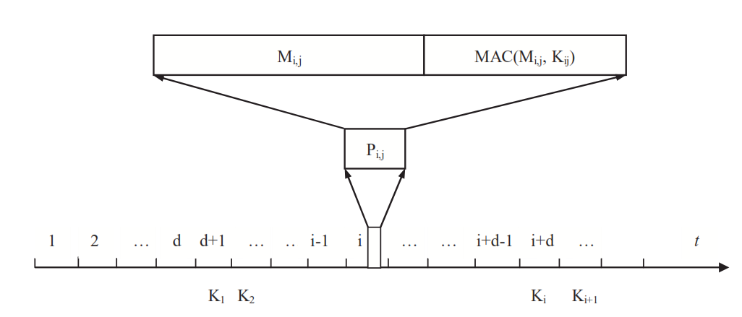
μ-TESLA (Authentication)

Slide 11
BABRA (Authentication)
Batch based broadcast authentication scheme
Broadcast packets are sent in batches and
Each batch is a burst sequences of packets
One key for each batch
All packets in one batch carry a MAC calculated based in that key
Key will be disclosed only after a certain delay from the end of the batch
No further packet will use the disclosed key.
Due this asymmetry attacker cannot inject bogus packet.
To authenticate each batch key, the hash of the key is embedded in the packets of the previous batches
Hence when one packet of the current batch is authenticated, the key hashed in it is used to authenticate the key of the next batch
Each key is independent. Hence it can be used by both network broadcast by BS and local broadcast by sensor nodes

Slide 12
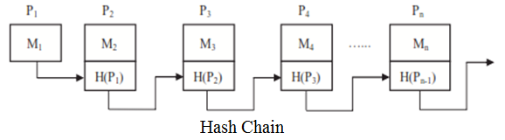
Block-Based Approach (Authentication)
To reduce the number of signature operations
The sender divides a broadcast / multicast stream into blocks, associates each block with a signature and spreads the effect of signature across all the packets in the block
The hashes form chains linking each packet to the block signature.
Each receiver verifies the block signature and authenticates all packets through the hash chains.
To tolerate packet loss, each packet is linked to multiple other packets and further to the block signature

Slide 13
Erasure coding (Authentication)
To disperse the effect of signature
A block consists of n packets
For each packet payload, a hash is computed.
A block signature is generated for the concatenation of all the hashes
Then the signature and all hashes are the input to an (m,n) erasure coding algorithm which outputs n pieces
Each packet in the block is attached with one piece before sent out
Each receiver can recover the original n hashes and the block signature if it receives at least m pieces
Merits:
Computationally efficient because the computation requirement is reduced to one signature operation plus some hash or decoding operation for a block of packets.
Demerits:
Hash chains and erasure codes establish relationship among all the packets in one block. The relationship makes the block based approach vulnerable to packet loss
Loss of certain number of packets can result in the failure of authentication of other received packets.
The block design requires the sender / receiver buffer a certain number of packets before processing them. A large block size can achieve higher computational efficiency but incurs longer buffering delay. Hence not suitable for live video show or stock quotes delivery

Slide 14
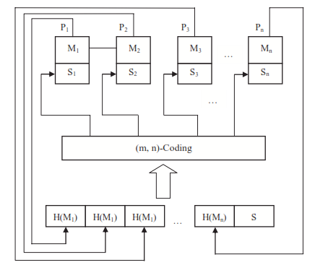
Erasure Coding (Authentication)

Slide 15
Multicast Authentication based on Batch Signature(MABS)
Uses asymmetric cryptography
Block Signature – supports the authentication of any number of packets simultaneously
Sender generates a signature for each outgoing packet with its private key
When receiver collects n packets p_{i}={m_{i}, s_{i}}, sends it BatchVerify(p₁, p₂, .. P_{n}) ∈{True, False}
Properties of BlockVerify()
Given a batch of packets that have been signed by the sender BatchVerify() outputs True
Given a batch of packets including some unauthenticated packets, the probability that BatchVerify() output True is very low
The computational complexity of BatchVerify() is increased gradually when the batch size increases
Merits: Eliminates the correlation among the packets and resilient to packet loss
Eliminates authentication latency
The receiver can verify the authenticity of all the received packets in its buffer anytime

Slide 16
Nonrepudiation
Assurance of the responsibility to an action
The source node should not be able to deny having sent a message and the destination should not be able to deny having received the message. [Nonrepudiation of origin and receipt.]
Defends against cheating parties.
Based on signature
Simple Protocol that fails
Sender sends signed message and destination sends signed reply → Destination may deny sending signed reply
Sender sends destination a commitment message, destination sends a signed reply and the sender sends the actual message → Sender may deny sending original message
Protocol should operate in multiple rounds
No. of rounds is kept secret and randomly chosen by the source
In each round the source need to send evidence for non-repudiation of origin and the destination replies an evidence for nonrepudiation of receipt.
Only after finishing all the rounds the destination able to recover the message
Trusted Third Party
Both source and destination has to interact with TTP in an online or offline way so that TTP collects enough evidences for nonrepudiation of both
Demerits
More complex without TTP
If TTP is used, TTP becomes a bottleneck of performance

Slide 17
Freshness
Packets is valid only for a limited time interval
A receiver should be able to assure that the packet is fresh
Packet Replaying
Attacker can intercept a packet from the network, hold it for any amount of time and then resend it into the network
Out-dated information in the packet may cause many problems to the applications deployed in the network
If some old routing control packets are replayed sensor nodes have inconsistent network topology and routing protocol will fail
Replaying of packet in space dimension: Wormhole attack
Attacker establishes a secret low-latency broadband channel between two distinct locations in a WSN.
Records packets at one location, tunnel them through the secret channel and replay them at other location
Replayed packets may still be fresh because the channel has a low latency
But this spatial change can distort the network topology by making two distant nodes believe they are neighbors, thus resulting in a serious attack to routing protocols.
These arrived packets should not be considered as fresh because they arrive at the time earlier than the expected time
Timestamp
Securely attaching the time stamp and location information in the packet
Receiver compares the time of sent with current time and checks if it is fresh or not.
Wormhole attacks can also be detected.
But requires strict synchronization in time domain.
Another way → Use of Sequence numbers→ But it has maximum range → Should have higher range such that the session completes before it reaches initial value again

Slide 18
Availability
Assurance of the ability to provide expected services
The DoS attack is related every aspect of network
Selective Forwarding
Dropping all packets
Dropping only packets from a specific node
Dropping packets intermittently
Detection of malicious node
If no. of packets dropped by a node exceeds certain threshold, all neighbors collaborate with other neighbors and forms a decision if the suspected node is a malicious node or not.
Radio Jamming
Constantly jamming an intended spectrum band so that all communication in the band
Introducing intermittent radio interference
Counter measure
Using Spread spectrum FHSS or UWB
Multipath Routing
Robust and secure data transmission services over insecure networks
Overcomes the impact of packet dropping or radio jamming at the cost of increased routing overhead
Source decomposes the message into many shares and spread those shares into multiple routes towards destination
Out of n shares if m shares are received, the message can be recovered.
Merits:
provides resistance to packet loss due to channel variance, packet dropping, jamming etc.
Confidentiality of the message can be strengthened because attackers have to compromise a certain number of routes to capture a message

Slide 19
False Reports
If data aggregator node is a malicious node then during the in-network processing it may generate false report and forward it to BS
Injection of false reports by such an malicious internal node cannot be solely solved by authentication because the internal malicious node will also have correct authentication keys.
To identify false reports
Uses witness nodes
A data report should be checked and signed by t witness nodes (those having similar observations) and also by the aggregator before it has been forwarded to BS
BS performs verification based on t+1 signatures to decide whether the report is valid or not
To avoid depletion of power in intermediate hops and BS in forwarding and processing false reports
Signatures carried by a report are verified by the nodes along the route from the aggregator to BS. If it found to be false, it is discarded immediately without further forwarding→ En-route Filtering
To implement this the nodes generating signatures have shared keys with the nodes along the route to BS.

Slide 20
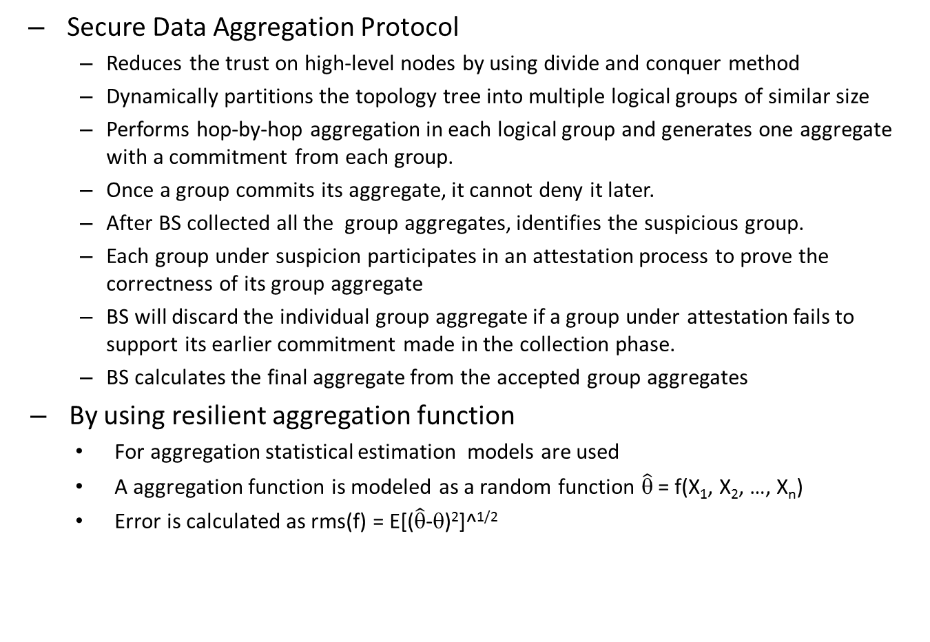
Secure Data Aggregation Protocol
Reduces the trust on high-level nodes by using divide and conquer method
Dynamically partitions the topology tree into multiple logical groups of similar size
Performs hop-by-hop aggregation in each logical group and generates one aggregate with a commitment from each group.
Once a group commits its aggregate, it cannot deny it later.
After BS collected all the group aggregates, identifies the suspicious group.
Each group under suspicion participates in an attestation process to prove the correctness of its group aggregate
BS will discard the individual group aggregate if a group under attestation fails to support its earlier commitment made in the collection phase.
BS calculates the final aggregate from the accepted group aggregates
By using resilient aggregation function
For aggregation statistical estimation models are used
A aggregation function is modeled as a random function $\hat{\text{θ}}$ = f(X₁, X₂, …, X_{n})
Error is calculated as rms(f) = E[($\hat{\text{θ}}$-θ)²]^^{1/2}

Slide 21
Intrusion Detection

Slide 22
Key Management
Symmetric Key Management
Key Agreement Models
Random Key Material Distribution
Deterministic Key Material Distribution
Location based Key Material Distribution
Asymmetric Key Management
Group Key Management

